Slide 1
Benchmarking ARM big.LITTLE
CPE-534
Operating Systems
Spring 2020
William Pannell

Slide 2
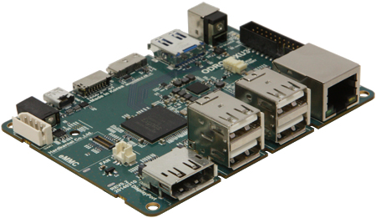
Unit Under Test
The Odroid-XU3
  Samsung Exynos 5422
    8 core big.LITTLE System on Chip
    4x ARM Cortex-A15 (2GHz)
    4x ARM Cortex-A7 (1.3GHz)
  2GB LPDDR3 (933MHz)
  micro-HDMI (Mali T-628 MP6 iGPU)
  10/100 Mbps Ethernet
  4X USB 2.0, 1X USB 3.0
  30pin GPIO
Specs and images sourced from wiki.odroid.com

Slide 3
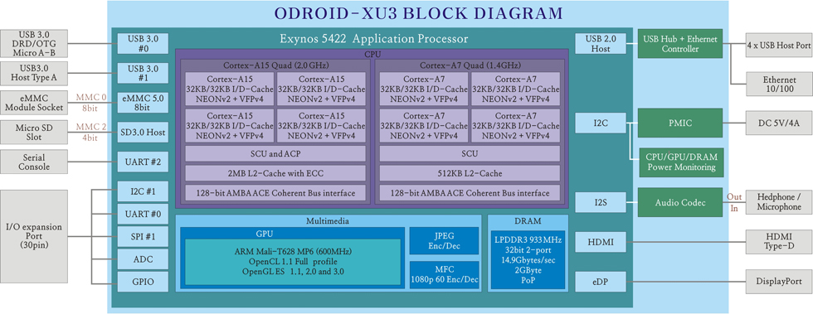
ARM big.LITTLE Architecture
Highlights:
“big” A15 Cores:
  32KB I/D cache per-core
  Cores share 2MB L2 cache
“LITTLE” A7 Cores
  32KB I/D cache per-core
  Cores Share 512KB L2 Cache
DRAM, GPU, and IO peripherals connected via 128-bit bus.
Block Diagram sourced from wiki.odroid.com

Slide 4
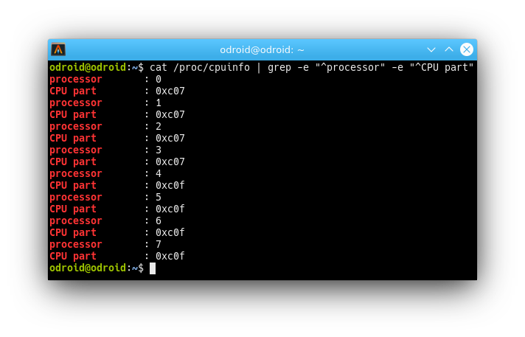
Identifying big.LITTLE cores
Use /proc/cpuinfo to get information about the CPU
  “processor” gives core enumeration
  “CPU part” Identifies the core type
    0xC07→Arm A7→LITTLE Core
    0xC0F→Arm A15→big Core
  Cores 0-3 are LITTLE, 4-7 big

Slide 5

Benchmarking with
7Zip has builtin Benchmarking
7z b [N] [-mmt{N}] [-md{N}]
  N runs
  -mmt{N} Benchmark using N threads
  -md{N} Benchmark with 2^N byte sample dict
    -md22 yields 4MB test file
    Tests start at 4MB and climb to -md{N} setting
    64MB test file crashes on this machine
Each run consists of 1 Compression and 1 Decompression
Summarized from 7zip manual
https://sevenzip.osdn.jp/chm/cmdline/commands/bench.htm

Slide 6
Benchmarking with
Compression
  Speed Depends upon:
    RAM Latency
    Data Cache Size/Speed (As opposed to Instruction Cache)
    TLB hit/miss
  Large Number of Random Accesses to RAM/Cache Memory
Decompression
  Speed Depends Upon:
    32bit integer operation latency (shift/mult/add)
    Branch (Mis)Prediction Penalty
    Conditional Execution
  No Special Extension Instructions (SSE,NEON,etc.)
Summarized from 7zip manual
https://sevenzip.osdn.jp/chm/cmdline/commands/bench.htm

Slide 7
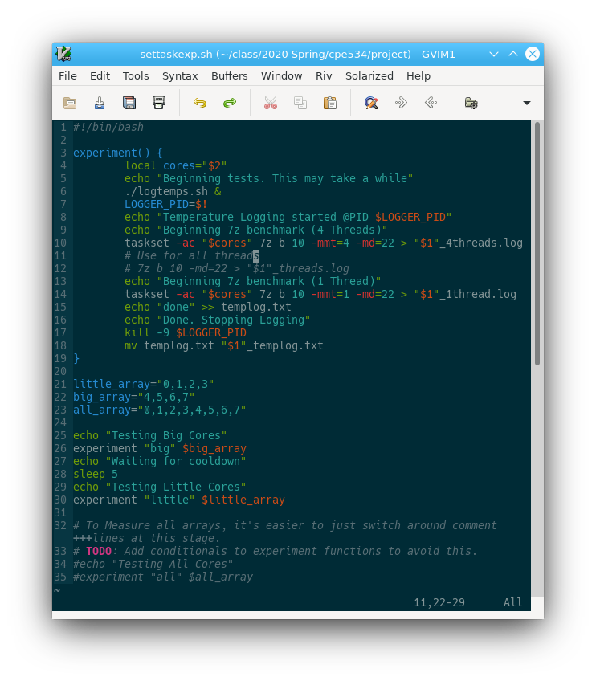
Methodology
Use taskset to pin 7z to cores
Perform 10 runs each using:
  4 big cores
  1 big core
  4 LITTLE cores
  1 LITTLE core
  All cores
Log temperature during tests

Slide 8
Compression Performance

Slide 9
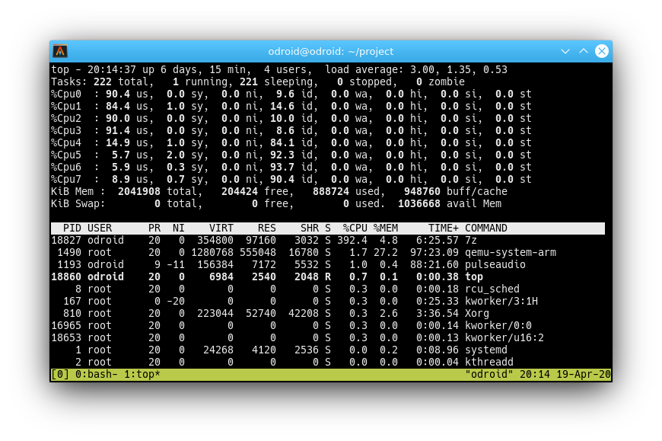
Compression – Core Utilization
Screen shot of Top Running during All Cores test
High Utilization on LITTLE cores, Low utilization of big cores
High idle time on big cores
Background processes not to blame

Slide 10
Decompression Performance

Slide 11
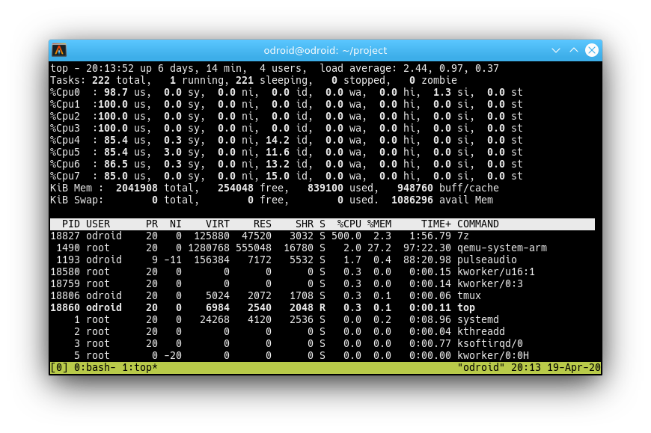
Decompression - Core Utilization
Screen shot of Top Running during All Cores test
Near 100% Utilization on all LITTLE cores
85% utilization of big cores
  Averaging 13.5% idle time on each big core
Background processes not to blame

Slide 12
Thermal Performance
Temperature logged during both 1 and 4 threaded tests
  4 Threads First
  1 Thread test begins at Dip
Evidence of Throttling During “All Threads” and “big cores 4 threads” runs
No evidence of Throttling During LITTLE cores runs.

Slide 13
Performance Summary
big ~2X faster than LITTLE
Cache constraints hurts LITTLE Compression performance
4 Thread Compression Experiences Bottlenecks
LITTLE punches above weight in integer-math-heavy workloads (decompression)
8 Core performance falls short of expectations due to thermal constraints.
Relative MIPS | Compression | Decompression
Big 4 Thread | 100.0% | 100.0%
Big 1 thread | 35.9% | 28.3%
LITTLE 4 thread | 44.3% | 60.6%
LITTLE 1 Thread | 15.4% | 15.5%
All cores | 112.9% | 120.6%

Slide 14
Further Experimentation
Improve Datalogging
  Monitor core frequencies to detect throttling
  Instrument DRAM/Cache usage (perf in linux-tools)
  Instrument Power Consumption
  Log each run individually
  Allow quantifying performance differences run-to-run
Split Compression/Decompression phases into discrete tests
  Provides better granularity of logging.
  No built-in support, but 7z is open source
Reduce Variables
  Kill other processes (X11, PulseAudio, Virtualized Guests, etc.)
  Migrate background tasks to other cores before starting tests
Goals
  Verify assumed bottlenecks
  Identify cause of low utilization during 4/8 threaded compression tests.
  Empower reasonable decisions (when to use big vs Little), in common workloads
  Optimize All-Core Performance vs Power consumption

Slide 15
Acknowledgments
UAH Faculty and Staff
  Providing Odroid cluster for experiments
Dr. Kulick
  Providing Topic/Encouragement
Raw data, Formatted Data, Test Scripts, and Presentation can be found at:
https://github.com/wcpannell/armbiglittle

